Slide 1


Department of Computer Science and Engineering
Home Insights: Price Prediction & Recommendations
B21A2425C12
Dr. Senthil Pandi S M.E.,Ph.D. Associate Professor
Madhumitha K 210701141
Mohana Prasath G 210701163

Slide 2
Problem Statement and Motivation
The real estate market faces significant challenges in accurately predicting property prices due to the complex interplay of various factors such as property size, location, economic conditions, and neighborhood features. Traditional valuation methods often fail to provide precise, up-to-date price estimates, which can lead to financial discrepancies for homebuyers, investors, and developers. With the increasing availability of detailed datasets, including location data, property features, and market trends, there is a growing opportunity to leverage advanced machine learning techniques to address this issue. This project aims to provide a reliable, data-driven solution for house price prediction, enabling stakeholders to make more informed decisions in a fluctuating real estate market.

Slide 3
Objectives
The primary objective of this project is to develop an advanced machine learning-based platform that predicts house prices with high accuracy by incorporating various data sources, including property size, location, and market trends. In Phase 1, the focus is on building a robust price prediction model using models like LightGBM and CatBoost, combined via a Voting Regressor. Phase 2 will focus on enhancing the model's performance through hyperparameter tuning and providing personalized property recommendations based on predicted prices and user preferences. The end goal is to offer a reliable, user-friendly tool for stakeholders in the real estate market.

Slide 4
Abstract
This project aims to develop a machine learning-based platform for predicting house prices, leveraging diverse datasets that include property features, geographical data, and market trends. In Phase 1, a Voting Regressor combining LightGBM and CatBoost models is implemented to predict house prices accurately. The platform uses input parameters such as the number of bedrooms, living area, location, and additional external factors like nearby amenities and market trends. Phase 2 will focus on optimizing the model’s performance through hyperparameter tuning and integrating a recommendation system to suggest properties based on user preferences. Ultimately, the project seeks to offer valuable insights for homeowners, investors, and developers, facilitating informed decisions in the dynamic real estate market.

Slide 5
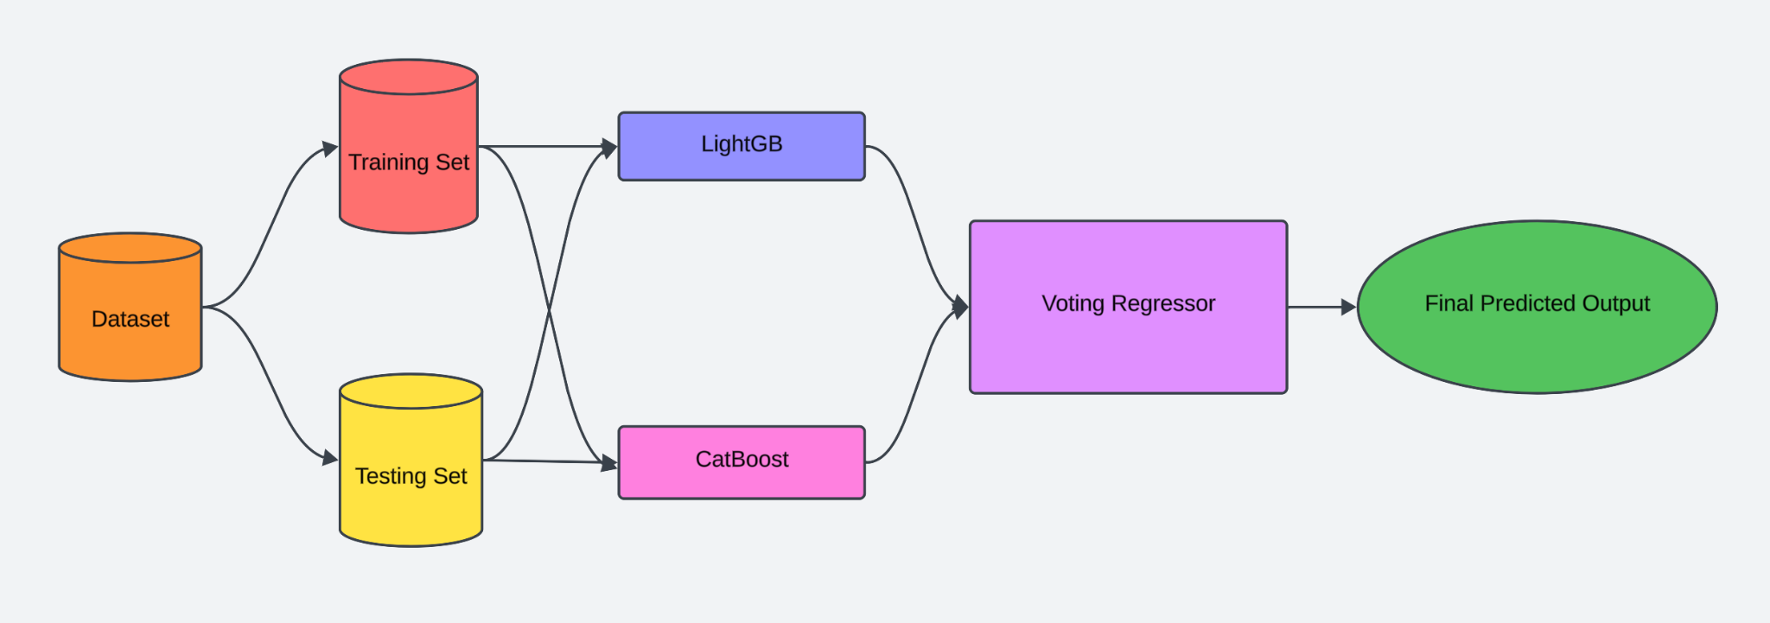
System Architecture

Slide 6
List of Modules
Prediction Module
Exploratory Data Analysis
Dataset Preprocessing
Model Selection And Model Training
Hyperparameter Tuning Module
Recommendation Module

Slide 7
Functional Description for Prediction Module
The House Price Prediction Module uses machine learning to estimate property values based on diverse input features, including structural attributes (e.g., number of bedrooms, bathrooms, living area), location-based data (latitude, longitude, postal code, distance from the airport), and contextual factors (number of nearby schools, renovation status, waterfront presence). The module begins with data preprocessing, ensuring the inputs are clean, scaled, and relevant. Using a Voting Regressor that combines LightGBM and CatBoost models, the system analyzes complex patterns in the data to generate accurate price predictions. This provides users with reliable insights into property valuations based on their specified criteria.

Slide 8
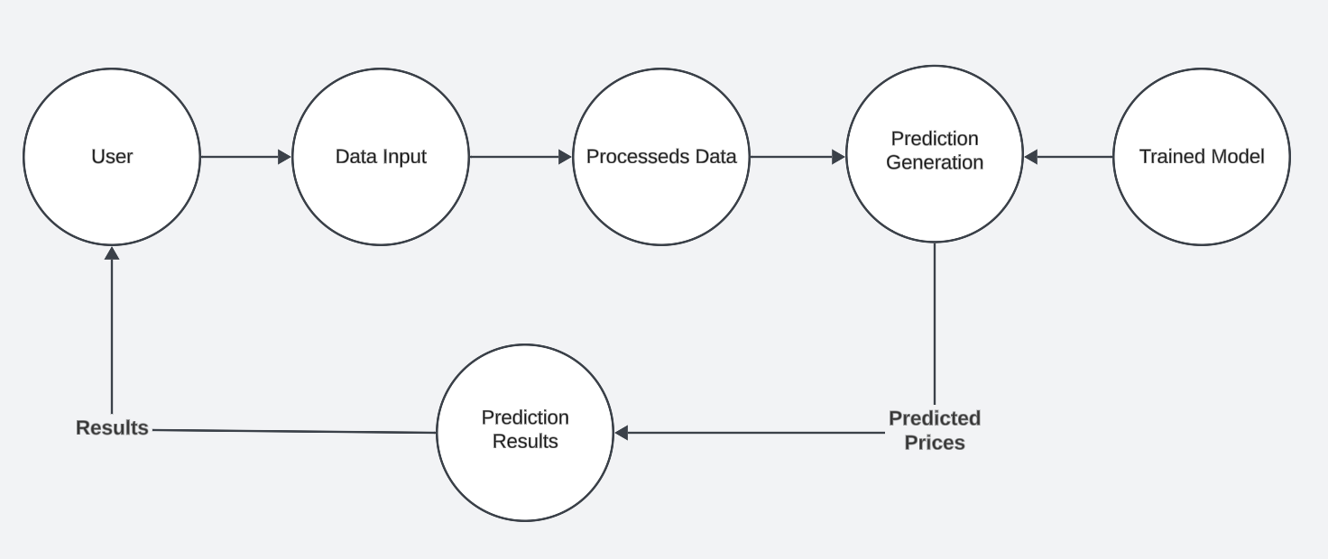
Data Flow Diagram For Prediction Module

Slide 9
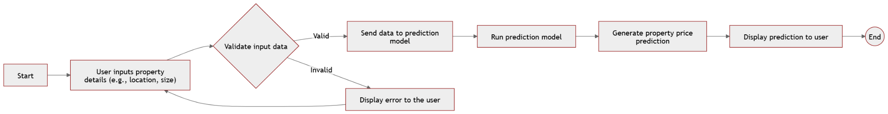
Activity Diagram for Prediction Module

Slide 10
Functional Description for Hyperparameter Tuning Module
The Hyperparameter Tuning Module is responsible for optimizing the machine learning model’s performance by finding the best hyperparameter combinations. Techniques like grid search, random search, or Bayesian optimization are employed to evaluate various parameter settings against the training dataset. By iteratively refining these parameters, the module ensures enhanced model accuracy and generalization. This module’s focus is to maximize the prediction model’s efficiency and robustness, ensuring better results in the dynamic real estate market.

Slide 11
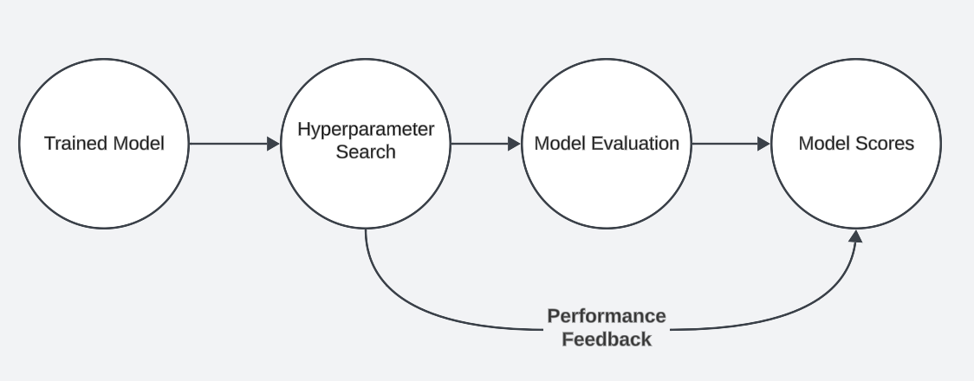
Data Flow Diagram for Hyperparameter Tuning Module

Slide 12
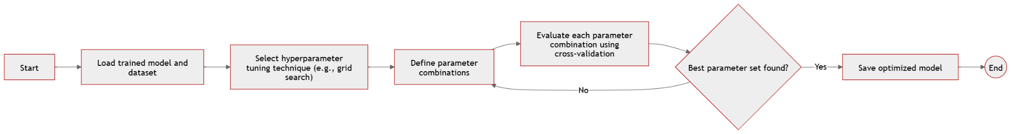
Activity Diagram for Hyperparameter Tuning Module

Slide 13
Functional Description for Recommendation Module
The Recommendation Module enriches the system by providing personalized property recommendations based on user preferences and predicted prices. It integrates contextual data such as market trends, local amenities, and user-defined parameters to generate tailored property suggestions. The module employs a recommendation engine that works in tandem with the Prediction Module, ensuring that users receive insightful suggestions for properties matching their criteria, ultimately aiding informed decision-making in property investment and purchases.

Slide 14
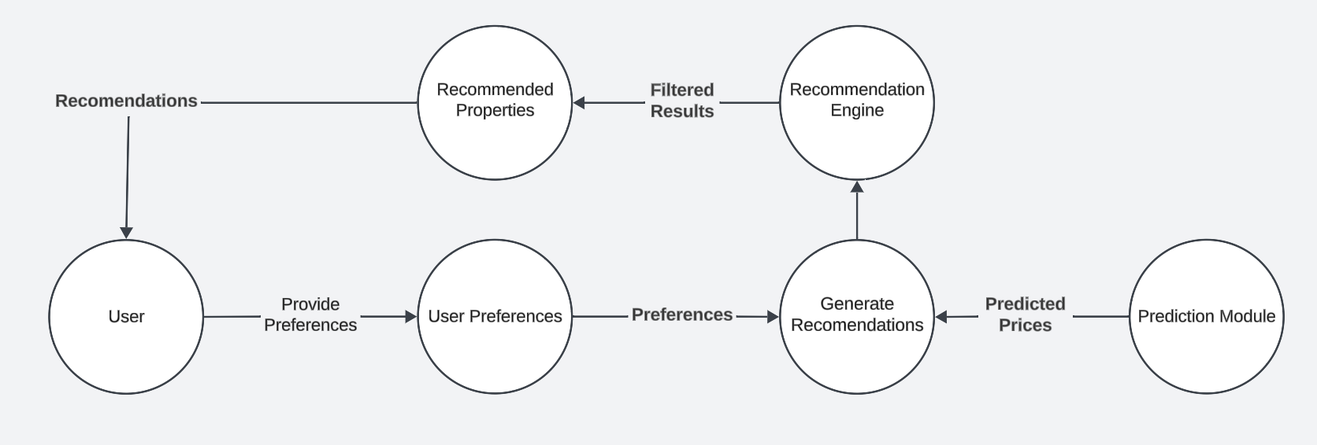
Data Flow Diagram for Recommendation Module

Slide 15
Activity Diagram for Recommendation Module

Slide 16
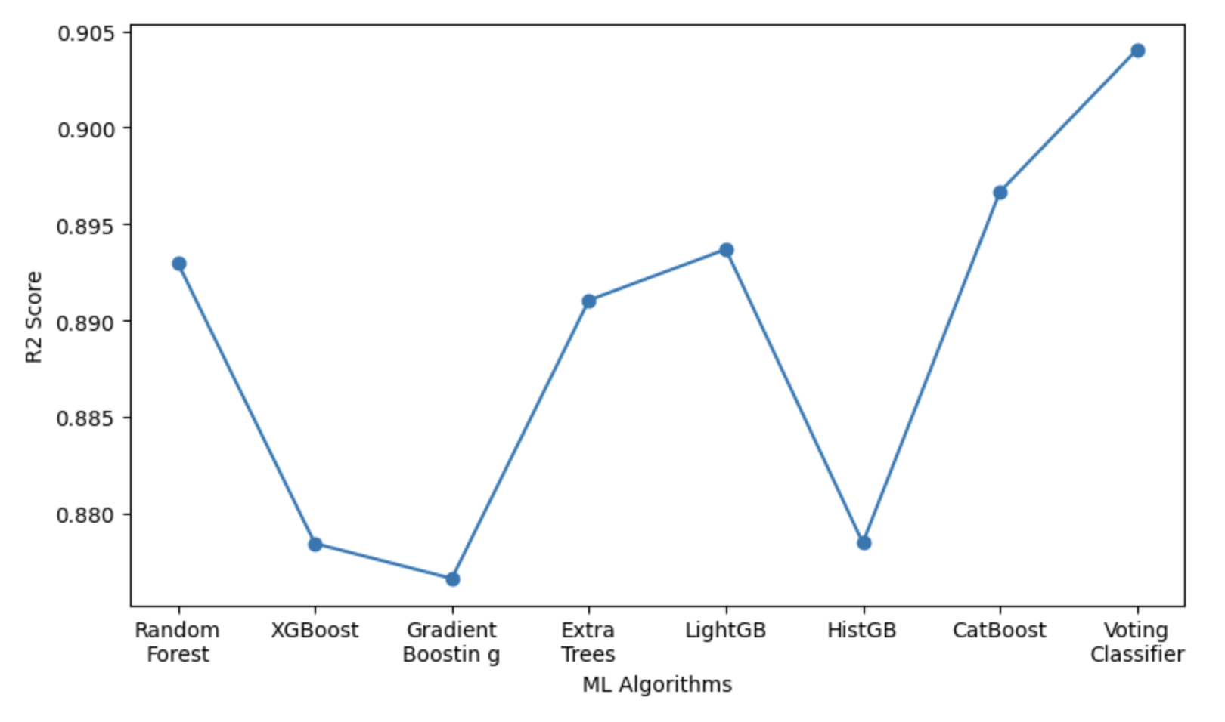
Implementation & Results of First Module
The graph showcases the R² scores of various machine learning algorithms used in the project to predict property prices. It evaluates the performance of models such as Random Forest, XGBoost, Gradient Boosting, Extra Trees, LightGBM, Histogram-based Gradient Boosting (HistGB), CatBoost, and the ensemble Voting Classifier.

Slide 17
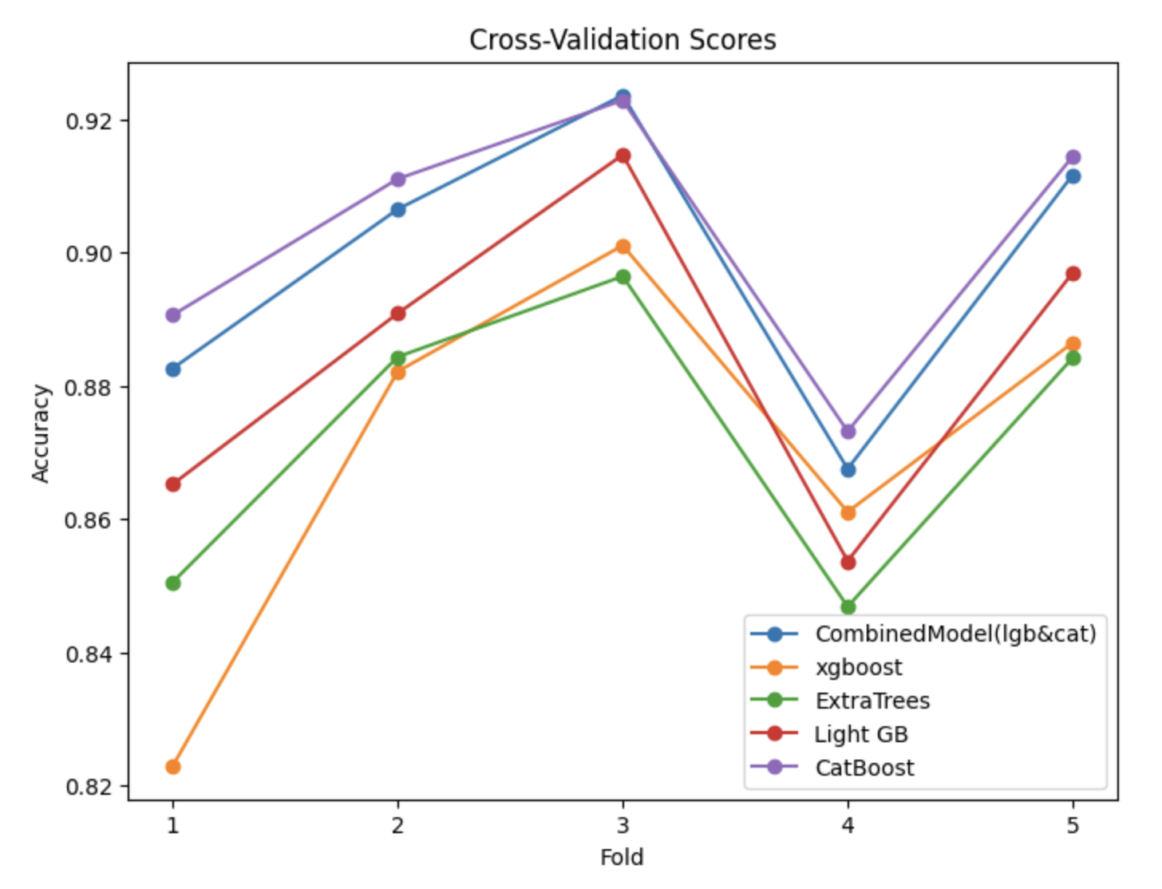
Implementation & Results of First Module
The R-squared scores from cross-validation were plotted for all models to visualize their consistency and robustness across different subsets of the dataset. The graph presented is a line chart depicting the cross-validation scores of various machine learning models across different folds. The y-axis shows the accuracy of the models, while the x-axis represents the fold number in the cross-validation process, with values ranging from 1 to 5.

Slide 18
Conclusion & Work for Phase II
The project demonstrated the effectiveness of machine learning, particularly ensemble models like LightGBM and CatBoost, in predicting property prices with high accuracy. Phase 2 will focus on enhancing performance and personalization through the Hyperparameter Tuning Module, optimizing model parameters using advanced techniques like Bayesian optimization, and the Recommendation Module, which will deliver tailored property suggestions by integrating user preferences, market trends, and contextual factors. These advancements aim to improve system precision, scalability, and user experience, making it a robust tool for real estate decision-making.

Slide 19
References
1. Hjort, Anders, Ida Scheel, Dag Einar Sommervoll, and Johan Pensar. "Locally interpretable tree boosting: An application to house price prediction." Decision Support Systems 178 (2024): 114106.
2. Adetunji, Abigail Bola, Oluwatobi Noah Akande, Funmilola Alaba Ajala, Ololade Oyewo, Yetunde Faith Akande, and Gbenle Oluwadara. "House price prediction using random forest machine learning technique." Procedia Computer Science 199 (2022): 806-813.
3. Wang, Lu, Guangxing Wang, Huan Yu, and Fei Wang. "Prediction and analysis of residential house price using a flexible spatiotemporal model." Journal of Applied Economics 25, no. 1 (2022): 503-522.

Slide 20
References
4. Hjort, Anders, Johan Pensar, Ida Scheel, and Dag Einar Sommervoll. "House price prediction with gradient boosted trees under different loss functions." Journal of Property Research 39, no. 4 (2022): 338-364.
5. Liu, Jun, and Zihan Ma. "Forecasting Housing Price Using GRU, LSTM and Bi-LSTM for California." In 2024 IEEE 2nd International Conference on Control, Electronics and Computer Technology (ICCECT), pp. 1033-1037. IEEE, 2024.
6. Jiang, Zhongyun, and Guoxin Shen. "Prediction of house price based on the back propagation neural network in the keras deep learning framework." In 2019 6th International Conference on Systems and Informatics (ICSAI), pp. 1408-1412. IEEE, 2019.

Slide 21
References
7. Özöğür Akyüz, Süreyya, Birsen Eygi Erdogan, Özlem Yıldız, and Pınar Karadayı Ataş. "A novel hybrid house price prediction model." Computational economics 62, no. 3 (2023): 1215-1232.
8. Lahmiri, Salim, Stelios Bekiros, and Christos Avdoulas. "A comparative assessment of machine learning methods for predicting housing prices using Bayesian optimization." Decision Analytics Journal 6 (2023): 100166.
9. Y. Zhao, J. Zhao and E. Y. Lam, "House Price Prediction: A Multi-Source Data Fusion Perspective," in Big Data Mining and Analytics, vol. 7, no. 3, pp. 603-620, September 2024.

Slide 22
References
10. F. Wang, Y. Zou, H. Zhang and H. Shi, "House Price Prediction Approach based on Deep Learning and ARIMA Model," 2019 IEEE 7th International Conference on Computer Science and Network Technology (ICCSNT), Dalian, China, 2019.
11. B. U. Sri, C. S. K. Reddy, C. R. Kumar, A. Vyshnavi, B. Vinod and B. K. Reddy, "Random Forest-based House Price Prediction," 2023 Second International Conference on Augmented Intelligence and Sustainable Systems (ICAISS), Trichy, India, 2023
12. S. Goswami, V. S. Bramhe and S. Khepra, "Prediction of House Price Using Stacked LSTM Model," 2022 4th International Conference on Advances in Computing, Communication Control and Networking (ICAC3N), Greater Noida, India, 2022.

Slide 23
References
13. Y. Chen, R. Xue and Y. Zhang, "House price prediction based on machine learning and deep learning methods," 2021 International Conference on Electronic Information Engineering and Computer Science (EIECS), Changchun, China, 2021
14. Ho, W. K. O., Tang, B.-S. and Wong, S. W. (2020) ‘Predicting property prices with machine learning algorithms’, Journal of Property Research, 38(1), pp. 48–70. doi: 10.1080/09599916.2020.1832558.
15. Thamarai, M. and Malarvizhi, S.P., 2020. House Price Prediction Modeling Using Machine Learning. International Journal of Information Engineering & Electronic Business, 12(2).

Slide 24
Paper Publication Status
PUBLICATION STATUS: Submitted to a conference.
TITLE OF THE PAPER: Ensemble-Based House Price Prediction using Boosting Regressors
AUTHORS: S. Senthil Pandi, Madhumitha K, Mohana Prasath G
NAME OF THE CONFERENCES: International Conference On Emerging Research In Computational Science - 2024

Slide 25
Thank You

